Slide 1
Data Structures and Algorithms
Lecture 7: Quick Sort (快速排序)
Data Science
United International College

Slide 2
Outline
Introduction to Quick Sort
Quick Sort Components
  Partitioning
  Small Array Strategy
  Picking the Pivot
Cost Analysis

Slide 3
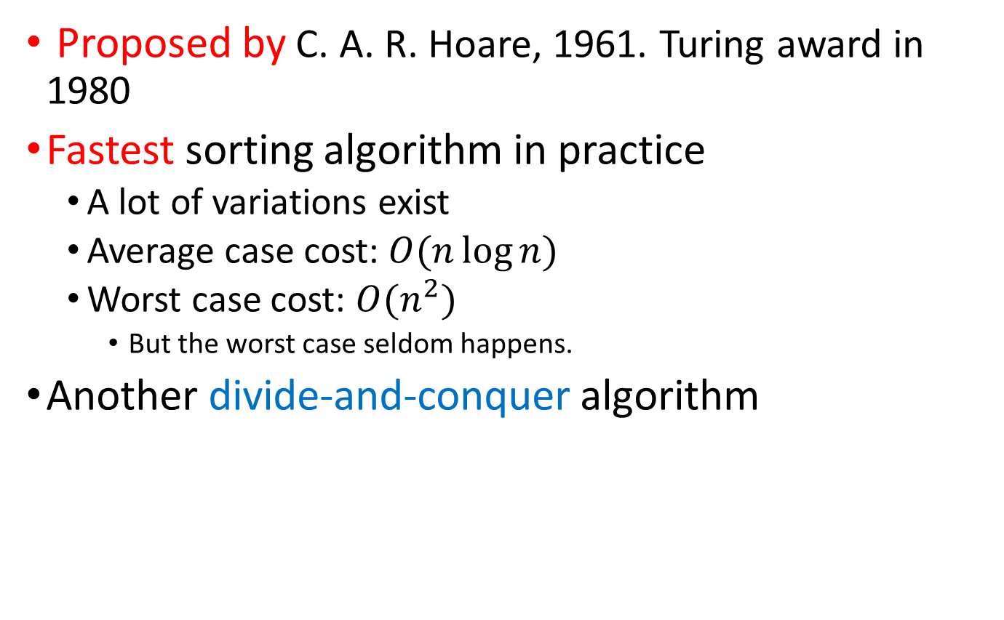
Introduction
Proposed by C. A. R. Hoare, 1961. Turing award in 1980
Fastest sorting algorithm in practice
  A lot of variations exist
  Average case cost: $O(n\log{n})$
  Worst case cost: $O(n^{2})$
    But the worst case seldom happens.
Another divide-and-conquer algorithm

Slide 4
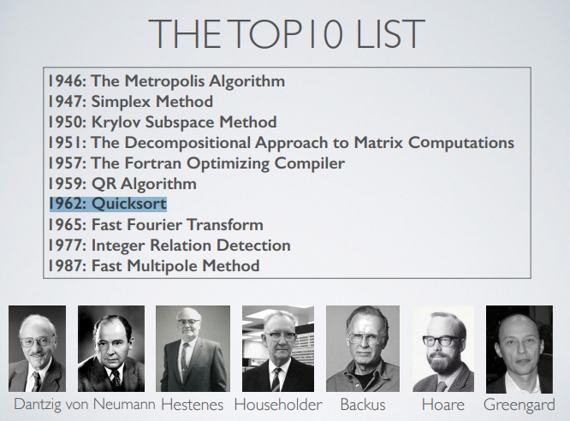
The TOP10 Algorithms From The 20th Century

Slide 5
Divide and Conquer
Divide
  Divide the problem into a number of subproblems that are smaller instances of the same problem.
Conquer
  Conquer the subproblems by solving them recursively. If the subproblem sizes are small enough, however, just solve the subproblems in a straightforward manner.
Combine
  Combine the solutions to the subproblems into the solution for the original problem.

Slide 6
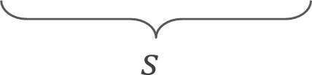
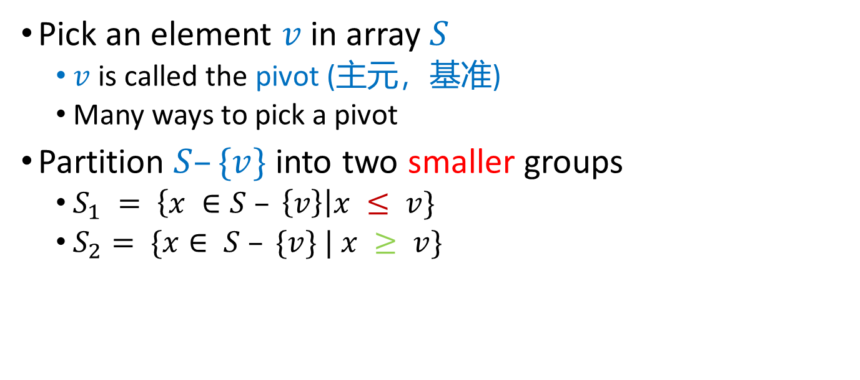
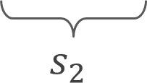
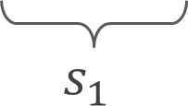
Divide
Pick an element $v$ in array $S$
  $v$ is called the pivot (主元，基准)
  Many ways to pick a pivot
Partition $S–\{v\}$into two smaller groups
  $S_{1} = \left\{x ∈S – \left\{v\right\}\right|x ≤ v\}$
  $S_{2}= \{x∈ S – \{v\} | x ≥ v\}$
$$s$$
v
v
$$s_{1}$$
$$s_{2}$$

Slide 7
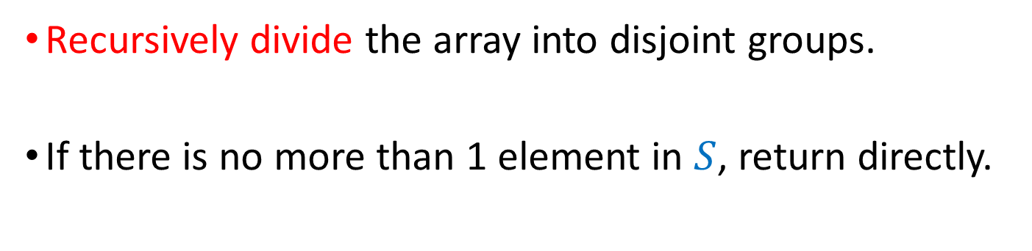
Conquer
Recursively divide the array into disjoint groups.
If there is no more than 1 element in $S$, return directly.

Slide 8
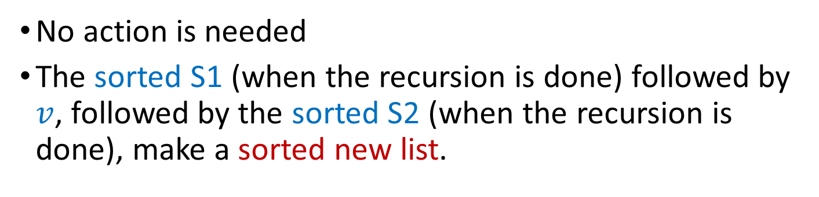
Combine
No action is needed
The sorted S1 (when the recursion is done) followed by $v$, followed by the sorted S2 (when the recursion is done), make a sorted new list.

Slide 9
Example
Pick a pivot | 2 | 6 | 1 | 4 | 9 | 5 | 3 | 0 | 7 | 8
Partition | 2 | 3 | 1 | 0 | 4 | 5 | 6 | 9 | 7 | 8
Pick a pivot | 2 | 3 | 1 | 0 | 4 | 5 | 6 | 9 | 7 | 8
Partition | 0 | 1 | 3 | 2 | 4 | 5 | 6 | 9 | 7 | 8
Pick a pivot | 0 | 1 | 3 | 2 | 4 | 5 | 6 | 9 | 7 | 8
Partition | 0 | 1 | 2 | 3 | 4 | 5 | 6 | 9 | 7 | 8
The right half can be solved similarly

Slide 10
Animation
Animation
Note that
  There are various methods to choose a pivot
  There are various methods to partition the array

Slide 11
Pseudo Code
QUICKSORT(A, left, right)
1. IF left >= right
2. return
3. q = PARTITION(A, left, right)
4. //q is the position of the pivot
// Partition A into two smaller subarrays
5. QUICKSORT(A, left, q-1)
6. QUICKSORT(A, q+1, right)

Slide 12
Partitioning
Partitioning
  This is a key step of the quicksort algorithm
  Goal: given the picked pivot, partition the remaining elements into two smaller sets
  Many ways to implement how to partition
    Even the slightest deviations may cause surprisingly bad results
We will learn an easy and efficient partitioning strategy here
How to pick a pivot will be discussed later

Slide 13
Partitioning Strategy
Partition an array A[left .. right]
  Get the pivot element out of the way by swapping it with the last element. (Swap pivot and A[right])
  Let i start at the first element and j start at the next-to-last element , i.e., i = left, j = right – 1
Pick a pivot | 2 | 6 | 1 | 4 | 9 | 5 | 3 | 0 | 7 | 8
Swap | 2 | 6 | 1 | 8 | 9 | 5 | 3 | 0 | 7 | 4
i
j

Slide 14
Partitioning Strategy
Goal:
  A[left...i] are smaller or equal to the pivot
  A[j…right] are greater or equal to the pivot
Strategy:
  When i < j
    Move i right, skipping over elements smaller than the pivot
    Move j left, skipping over elements greater than the pivot
    When both i and j have stopped
      A[i] >= pivot
      A[j] <= pivot { A[i] and A[j] should now be swapped }
Scan | 2 | 6 | 1 | 8 | 9 | 5 | 3 | 0 | 7 | 4
i
i
j
j

Slide 15
Partitioning Strategy
When i and j have stopped and i is to the left of j (thus legal)
  Swap A[i] and A[j]
    And then both elements are on the “correct” side
  After swapping
    A[i] <= pivot
    A[j] >= pivot
  Repeat the process until i and j cross
Swap | 2 | 0 | 1 | 8 | 9 | 5 | 3 | 6 | 7 | 4
i
j

Slide 16
Partitioning Strategy
Scan | 2 | 0 | 1 | 8 | 9 | 5 | 3 | 6 | 7 | 4
i
j
Swap | 2 | 0 | 1 | 3 | 9 | 5 | 8 | 6 | 7 | 4
i
j
Scan | 2 | 0 | 1 | 3 | 9 | 5 | 8 | 6 | 7 | 4
j
i
i and j cross now!

Slide 17
Partitioning Strategy
When i and j have crossed
  Swap A[i] and pivot
Result: p= i
  A[p] <= pivot, for p < i
  A[p] >= pivot, for p > i
Partition complete
Scan | 2 | 0 | 1 | 3 | 4 | 5 | 8 | 6 | 7 | 9
j
i

Slide 18
Pseudo Code for Partition
PARTITION(A, left, right)
1. p = PIVOT(A, left, right)
2. //p is the position of the pivot
3. swap A[p] and A[right]
4. i = left, j = right-1, pivot = A[right]
5. WHILE true
6. WHILE i<right AND A[i]<pivot
7. i++
8. WHILE j>=left AND A[j]>pivot
9. j--
10. IF i<j
11. swap A[i++] and A[j--]
12. ELSE
13. BREAK
14. swap A[i] and A[right]
15. return i
Notes:
Another version of partition: https://www.cnblogs.com/asiacao/archive/2012/12/17/2822090.html

Slide 19
Small Arrays
For very small arrays, quicksort does not perform as well as insertion sort
  how small depends on many factors, such as the time spent making a recursive call, the compiler, etc
Do not use quicksort recursively for small arrays
  Instead, use a sorting algorithm that is efficient for small arrays, such as insertion sort

Slide 20
Quick Sort + Small Array Strategy
QUICKSORT(A, left, right)
1. IF left >= right - 10
2. INSERTIONSORT(A, left, right)
3. return
4. q = PARTITION(A, left, right)
5. //q is the position of the pivot
6. QUICKSORT(A, left, q-1)
7. QUICKSORT(A, q+1, right)

Slide 21
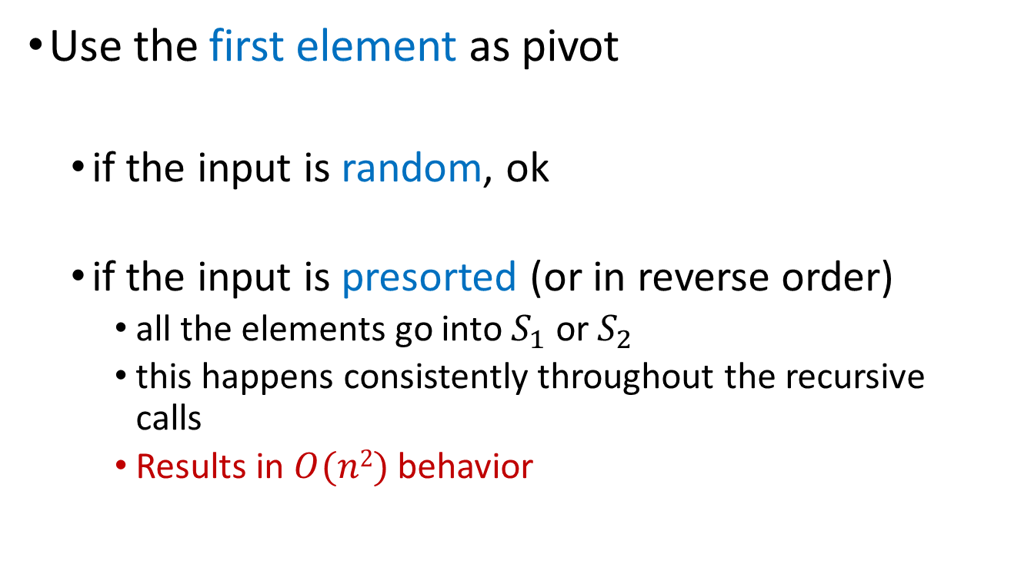
Picking the Pivot- Strategy 1
Use the first element as pivot
  if the input is random, ok
  if the input is presorted (or in reverse order)
    all the elements go into $S_{1}$ or $S_{2}$
    this happens consistently throughout the recursive calls
    Results in $O(n2)$ behavior

Slide 22
Picking the Pivot- Strategy 2
Choose the pivot randomly
  generally safe
  random number generation can be expensive

Slide 23
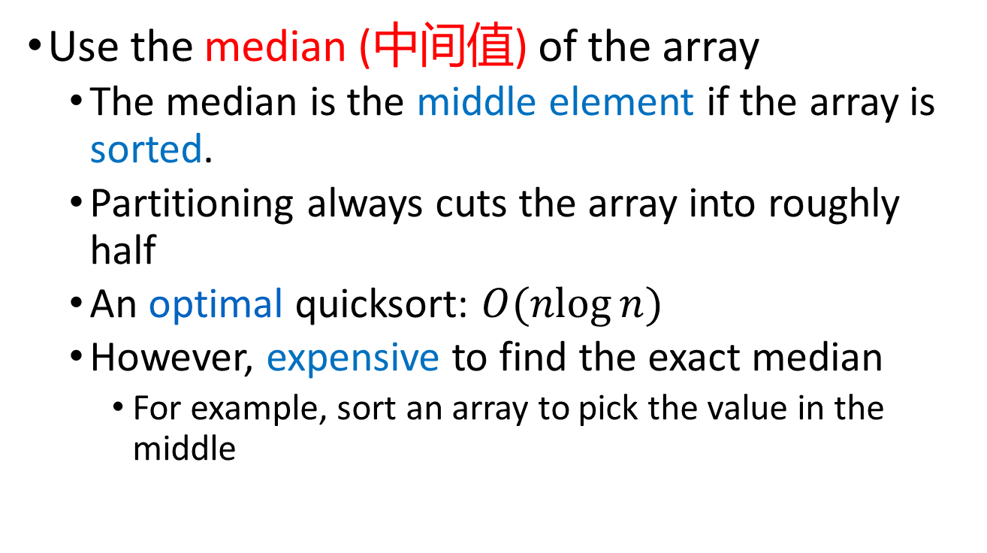
Picking the Pivot- Strategy 3
Use the median (中间值) of the array
  The median is the middle element if the array is sorted.
  Partitioning always cuts the array into roughly half
  An optimal quicksort: $O(nlog⁡n)$
  However, expensive to find the exact median
    For example, sort an array to pick the value in the middle

Slide 24
Picking the Pivot- Strategy 4
We will use median of three elements
  Compare just three elements: the left most, right most and center
  Swap these elements if necessary so that
    A[left] = Smallest
    A[right] = Largest
    A[center] = Median of three
  Pick A[center] as the pivot
  Swap A[center] and A[right – 1] so that pivot is at second last position
    Why? j=right-1-1

Slide 25
Median3 Example
median3 | 2 | 6 | 1 | 4 | 9 | 5 | 3 | 0 | 8 | 7
reposition | 2 | 6 | 1 | 4 | 7 | 5 | 3 | 0 | 8 | 9
pick pivot | 2 | 6 | 1 | 4 | 7 | 5 | 3 | 0 | 8 | 9
swap | 2 | 6 | 1 | 4 | 8 | 5 | 3 | 0 | 7 | 9
i
j

Slide 26
Partition with Median3
PARTITION(A, left, right)
1. MEDIAN3(A, left, right)
2. // MEDIAN3 repositions the left, center, and
3.//the right elements, and Swap A[center] and A[right-1]
4. i = left+1, j = right-2, pivot = A[right-1]
5. WHILE true
6. WHILE A[i]<pivot
7. i++
8. WHILE A[j]>pivot
9. j--
10. IF i<j
swap A[i] and A[j]
i++, j--
13. ELSE
14. BREAK
15. swap A[i] and A[right-1]
16. return i
The pivot
No boundary check. Why?

Slide 27
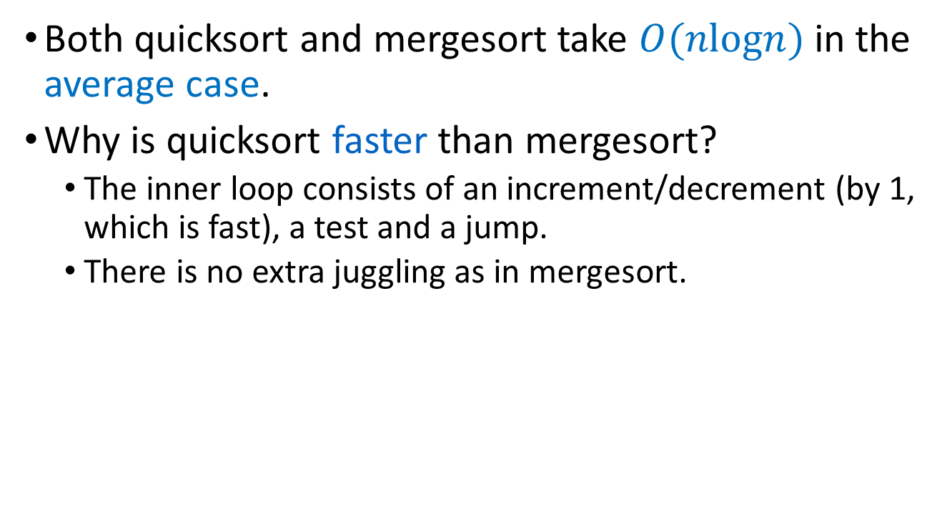
Quicksort VS Mergesort
Both quicksort and mergesort take $O(nlogn⁡)$in the average case.
Why is quicksort faster than mergesort?
  The inner loop consists of an increment/decrement (by 1, which is fast), a test and a jump.
  There is no extra juggling as in mergesort.
Notes:
Quick sort only has a single increment or decrement;
But for merge sort, has B[i++] = A[i1++] slower.

Slide 28

Analysis
Assumptions
  Pivot Selection: Median of 3 elements
  Base Case: Array size <= 10
Running time T(n)
  Divide
    Pivot selection: O(1)
    Partitioning: O(n)
    Recursive calls: T(i) + T(n-i-1)
      i: number of elements in S1
  Conquer and Combine: O(1)
$$T\left(n\right)=T\left(i\right)+T\left(n−i−1\right)+O\left(n\right),$$
$$where i is the position of the pivot.$$

Slide 29
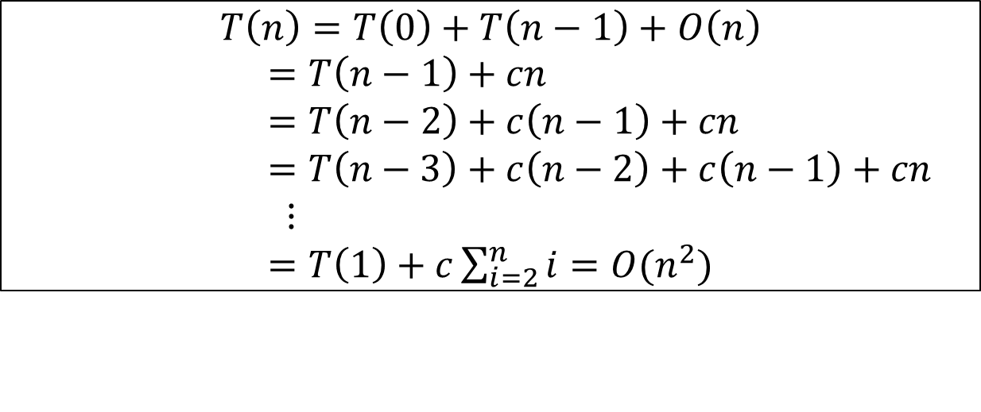
Worst-Case Analysis
What will be the worst case?
  The pivot is the smallest element, all the time
  Partition is always unbalanced
$$T\left(n\right)=T\left(0\right)+T\left(n−1\right)+O\left(n\right)$$
$=T\left(n−1\right)+cn$
$=T\left(n−2\right)+c\left(n−1\right)+cn$
$=T\left(n−3\right)+c\left(n−2\right)+c\left(n−1\right)+cn$
$⋮$
$=T\left(1\right)+c\sum_{i=2}^{n}{i=O(n^{2})}$

Slide 30
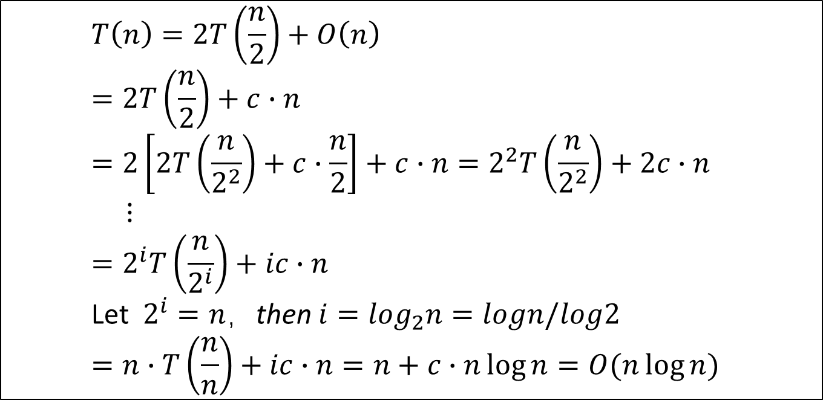
Best-case Analysis
What will be the best case?
  Partition is perfectly balanced
  Pivot is always in the middle (median of the array)
    $$T\left(n\right)=2T\left(\frac{n}{2}\right)+O\left(n\right)$$
    $$=2T\left(\frac{n}{2}\right)+c∙n$$
    $$=2\left[2T\left(\frac{n}{2^{2}}\right)+c∙\frac{n}{2}\right]+c∙n=2^{2}T\left(\frac{n}{2^{2}}\right)+2c∙n$$
    $⋮$
    $$=2^{i}T\left(\frac{n}{2^{i}}\right)+ic∙n$$
    Let $2^{i}=n，$then $i=\log_{2}n=logn/log2$
    $$=n∙T\left(\frac{n}{n}\right)+ic∙n=n+c∙n\log{n}=O(n\log{n})$$

Slide 31
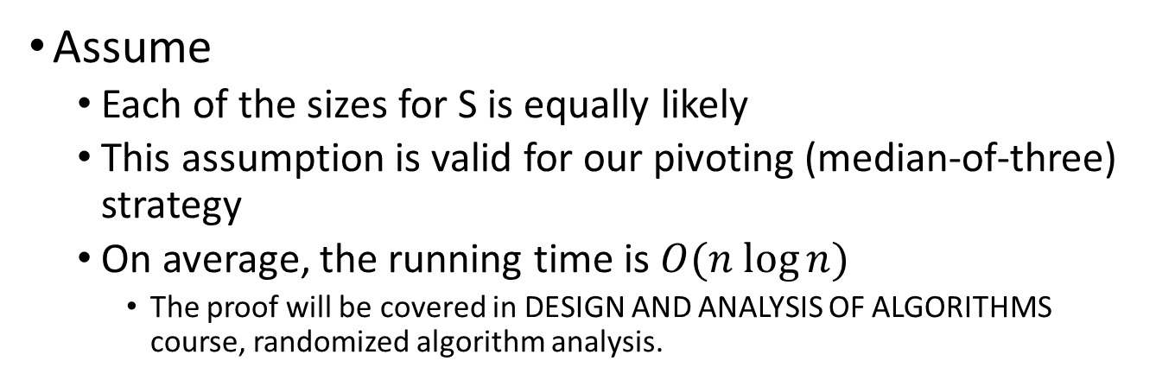
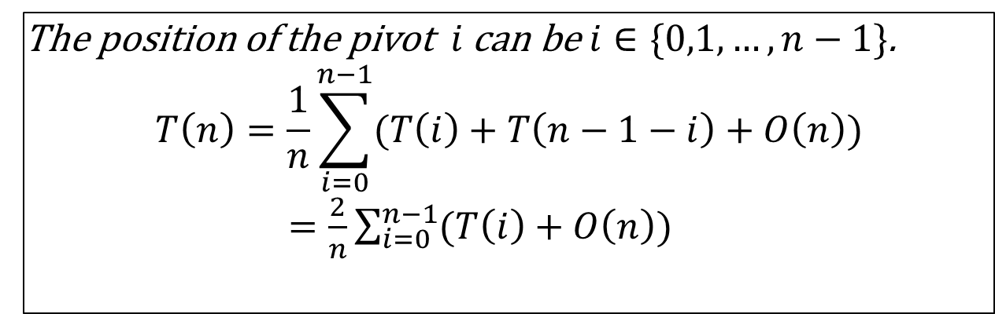
Average-case Analysis
Assume
  Each of the sizes for S is equally likely
  This assumption is valid for our pivoting (median-of-three) strategy
  On average, the running time is $O(n log⁡n)$
    The proof will be covered in DESIGN AND ANALYSIS OF ALGORITHMS course, randomized algorithm analysis.
The position of the pivot $i$ can be $i∈\{0,1,…,n−1\}$.
$$T\left(n\right)=\frac{1}{n}\sum_{i=0}^{n−1}{(T\left(i\right)+T\left(n−1−i\right)+O\left(n\right))}$$
$=\frac{2}{n}\sum_{i=0}^{n−1}{(T\left(i\right)+O\left(n\right))}$

Slide 32
Special Case
When all elements are the same?
Notes:
For all elements are the same, as we use strict ‘<’ and ‘>’, so we might get perfect O(n log n) performance, because half the equal elements will be split evenly in the two partitions.
If we use <= or >= then, results in worst case, unbalanced partition.

Slide 33
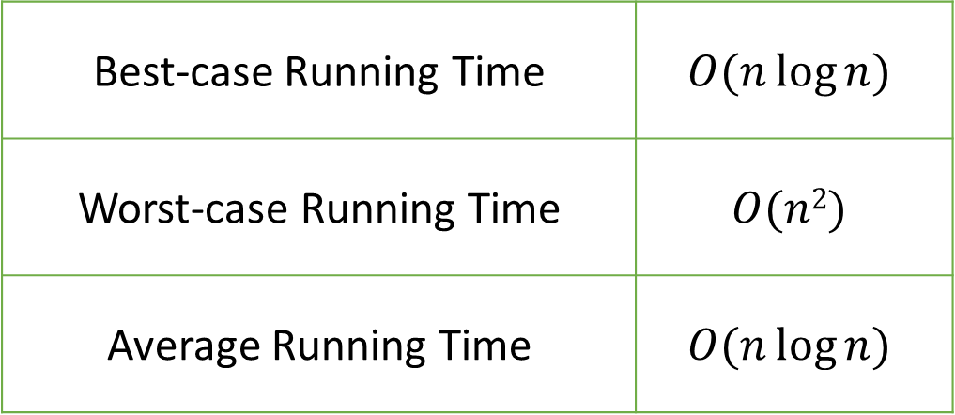
Analysis of Quick Sort
Best-case Running Time | $$O(n\log{n})$$
Worst-case Running Time | $$O(n2)$$
Average Running Time | $$O(n\log{n})$$
Quick sort is not stable. For example: sort A={1,1,1,1}
But it is the fastest in practice
The worst case seldomly happens

Slide 34
Lab task
Submit Lab7.cpp to iSpace which includes the following functions:
  void QuickSort(int *A, int left, int right)
    Sort array A[left..right] using quick sort
    Pivot is picked using median-of-3
  int main(void)
    Let n be the size of the input array, for n=10 and n=10⁵ do the following operations
    Generate an array, A1, consisting of n random integers
      Note: Use malloc to claim an array
    Sort A1 using QuickSort()
    For input size n =10 , print the array before and after sorting For input size n =10⁵ ,print elapsed time in milliseconds for QuickSort function.

